Slide 1

Unit 02.03.01
CS 5220:
COMPUTER COMMUNICATIONS
Medium Access Control
XIAOBO ZHOU, Ph.D.
Professor, Department of Computer Science

Slide 2
Medium Access Control
Broadcast LANs
  Simple and Cheap
  All information sent to all users
  No routing
Medium Access Control
  How to coordinate access to shared medium

Slide 3
Multiple Access Communications
Shared media basis for broadcast networks
  Inexpensive: radio over air; copper or coaxial cable
  M users communicate by broadcasting into medium
Key issue: How to share the medium when there is a competition for it?
3
2
4
1
Shared multiple
access medium
M
5
…

Slide 4
Approaches to Media Sharing
Medium sharing techniques
Static channelization
Dynamic medium access control
Partition medium
Dedicated allocation to users
Satellite transmission
Cellular Telephone
Scheduling
Random access
Polling: take turns
Request for slot in transmission schedule
Token ring
Wireless LANs
Loose coordination
Send, wait, retry if necessary
Aloha
Ethernet

Slide 5
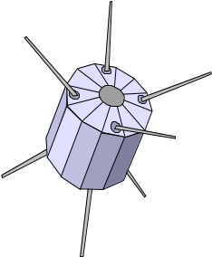

Channelization Example: Satellite
Satellite Channel
uplink f_{in}
downlink f_{out}

Slide 6


Channelization: Cellular
uplink f₁ ; downlink f₂
uplink f₃ ; downlink f₄

Slide 7
Why Channelization?
Channelization
  Semi-static bandwidth allocation of portion of shared medium to a given user
Highly efficient for constant-bit rate traffic
Preferred approach in
  Cellular telephone networks
  Terrestrial & satellite broadcast radio & TV

Slide 8
Channelization Approaches
Frequency Division Multiple Access (FDMA)
  Frequency band allocated to users
  Broadcast radio & TV, analog cellular phone
Time Division Multiple Access (TDMA)
  Periodic time slots allocated to users
  Telephone backbone, GSM digital cellular phone
Code Division Multiple Access (CDMA)
  Code allocated to users
  Cellular phones, 3G cellular

Slide 9
Why not Channelization?
Inflexible in allocation of bandwidth to users with different requirements
Inefficient for bursty traffic
Does not scale well to large numbers of users
Dynamic MAC much better at handling bursty traffic

Slide 10
Scheduling: Token-Passing
token
Ring networks
Data to M
Station that holds token transmits into ring

Slide 11
Scheduling: Polling
Inbound line
Data from 1
Poll 1
Outbound line
Host
computer
1
2
3
M
Stations

Slide 12
Random Access
Multi-tapped (mulit-access) Bus
Collision!!
Transmit when ready
Transmission collisions can occur; need retransmission strategy

Slide 13
Delay-Bandwidth Product
Delay-bandwidth product is key parameter
  Coordination in sharing medium involves using bandwidth (explicitly or implicitly)
  Difficulty of coordination commensurate with delay-bandwidth product
Delay-bandwidth product is 2( t_{prop} + t_{proc} ) * R, or RTT * R (if t_{proc} is negligible)

Slide 14
Two-Station Example
Simple two-station example
  Station with frame to send listens to channel and transmits if channel found idle
  Station monitors channel to detect collision
  If collision occurs, station that begin transmitting earlier retransmits (the propagation time is fixed & known between two stations)
A
B

Slide 15
Two-Station MAC Example – CASE I
Two stations are trying to share a common channel
Distance d meters
t_{prop} = d / ν seconds
A transmits at t = 0
A
B
Case 1
B does not transmit before t = t_{prop} & A captures channel
A
B

Slide 16
Two-Station MAC Example – Case II
Two stations are trying to share a common medium
Distance d meters
t_{prop} = d / ν seconds
A transmits at t = 0
A
B
Case 2
B transmits before t = t_{prop} and detects
collision soon
thereafter
A
B
A detects
collision at
t = 2 t_{prop}
A
B

Slide 17
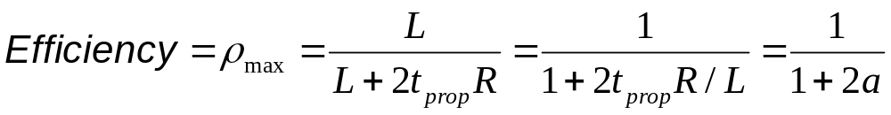
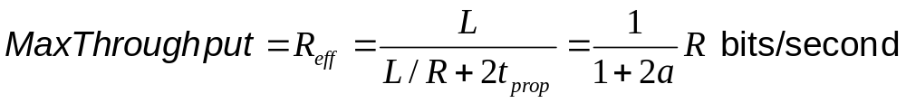
Efficiency of Two-Station Example
Each frame transmission requires 2t_{prop} of quiet time
  Station B needs to be quiet t_{prop} before and after time when Station A transmits
  R transmission bit rate (bandwidth)
  L bits/frame

Slide 18
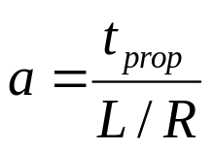
Summary: Normalized Delay-Bandwidth
Normalized Delay-bandwidth product plays a key role in performance of medium access control protocols
Propagation delay
Time to transmit a frame

